Slide 1
K-Means Clustering

Slide 2
K-Means CLustering
K-Means Clustering groups similar data points into clusters without needing labeled data. It is used to uncover hidden patterns when the goal is to organize data based on similarity.

Slide 3
Applications
Why Use K-Means Clustering?
K-Means is popular in a wide variety of applications due to its simplicity, efficiency and effectiveness. Here’s why it is widely used:
Data Segmentation: One of the most common uses of K-Means is segmenting data into distinct groups. For example, businesses use K-Means to group customers based on behavior, such as purchasing patterns or website interaction.

Slide 4
Image Compression: K-Means can be used to reduce the complexity of images by grouping similar pixels into clusters, effectively compressing the image. This is useful for image storage and processing.
Anomaly Detection: K-Means can be applied to detect anomalies or outliers by identifying data points that do not belong to any of the clusters.

Slide 5
Document Clustering: In natural language processing (NLP), K-Means is used to group similar documents or articles together. It’s often used in applications like recommendation systems or news categorization.
Organizing Large Datasets: When dealing with large datasets, K-Means can help in organizing the data into smaller, more manageable chunks based on similarities, improving the efficiency of data analysis.

Slide 6
K-Means -Algorithm
Initialization: We begin by randomly selecting k cluster centroids.
Assignment Step: Each data point is assigned to the nearest centroid, forming clusters by calculating distance between points to centroids(Minimum distance –point to centroid will be considered).
Update Step: After the assignment, we recalculate the centroid of each cluster by averaging the points within it.
Repeat: This process repeats until the centroids no longer change or the maximum number of iterations is reached.

Slide 7
What is K value in K-Means Clustering?
The K value in K-means clustering simply means:K in K-means clustering represents the number of clusters into which the dataset is partitioned.
The number of clusters (groups) you want to divide your data into.
Simple Explanation
If K = 2 → Data is divided into 2 clusters
If K = 3 → Data is divided into 3 clusters
If K = 5 → Data is divided into 5 clusters

Slide 8
Choosing K-Value
Elbow Method (most popular)
Silhouette Score
Domain knowledge

Slide 9
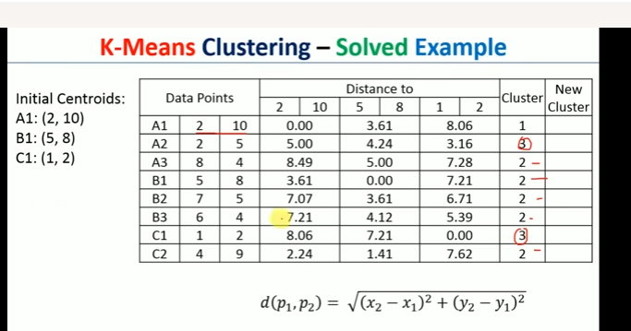

Slide 10
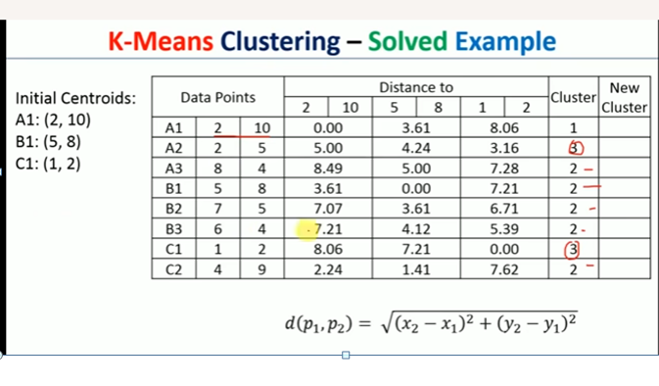

Slide 11
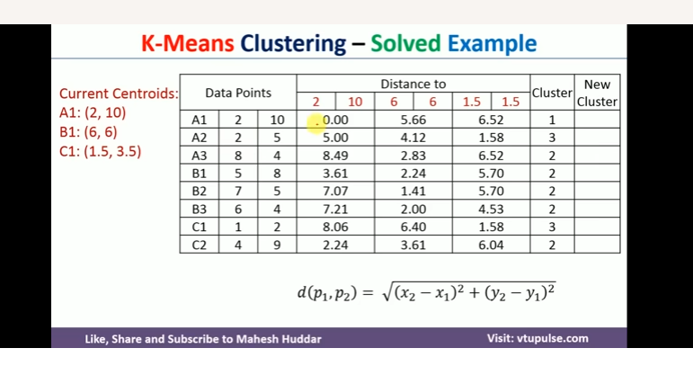

Slide 12
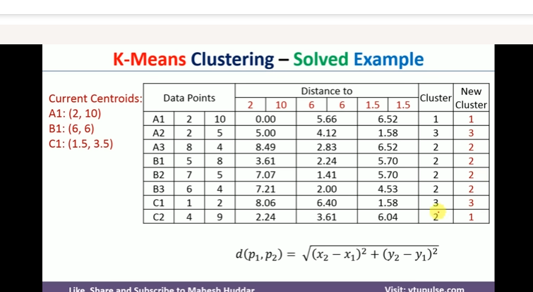

Slide 13
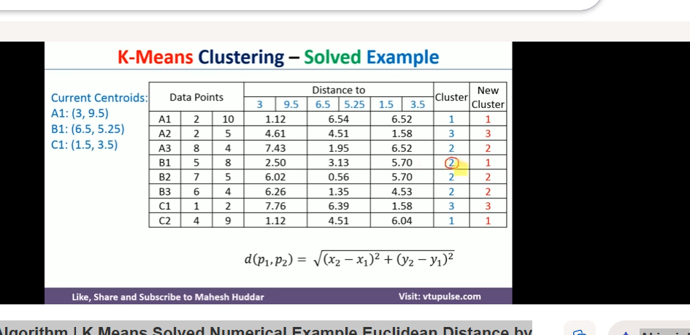

Slide 14
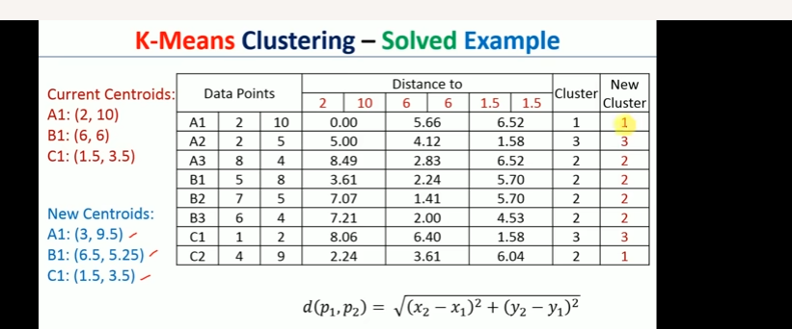

Slide 15
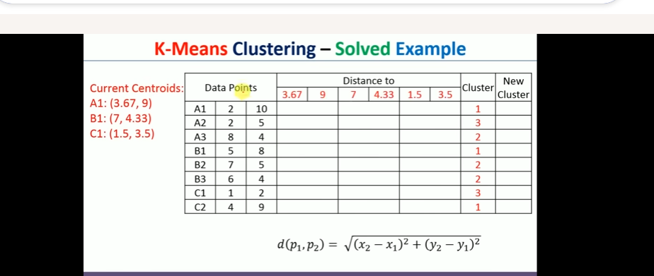

Slide 16
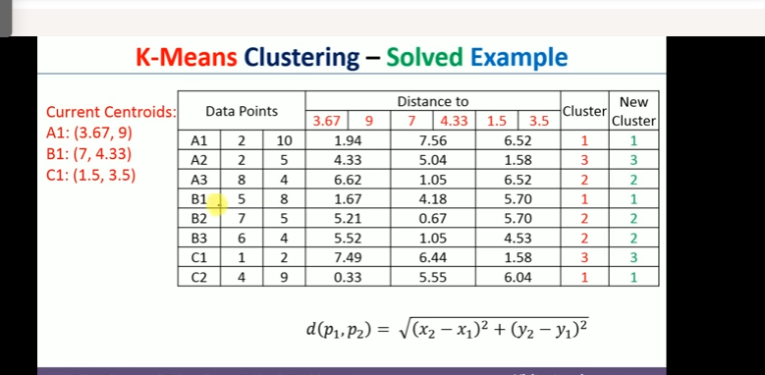

Slide 17
Fuzzy Clustering - ML
Fuzzy clustering allows each data point to belong to multiple clusters with different membership values. Instead of assigning a point to just one group, it captures how strongly a point relates to each cluster.
Uses membership scores between 0 and 1
Handles overlapping or unclear cluster boundaries
More flexible than hard clustering methods
Useful when data points don’t fit neatly into a single group

Slide 18
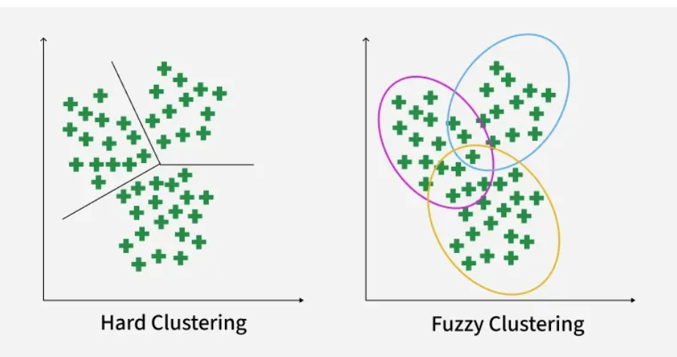

Slide 19
Working of Fuzzy Clustering
Fuzzy clustering assigns each data point a degree of membership for every cluster and updates these values through an iterative process. Here’s how it works:
Step 1: Initialize Membership Values Randomly: Each data point is given random membership scores for all clusters. A point can partially belong to multiple cluster

Slide 20
For example, for 2 clusters and 4 data points, an initial membership matrix (γγ) might look like:

Slide 21
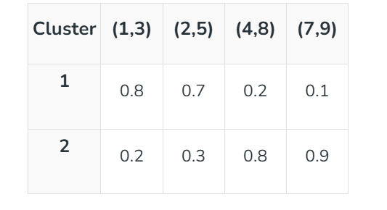

Slide 22
Step 2: Compute Cluster Centroids: Centroids are calculated as weighted averages, where weights are membership values raised to the fuzziness parameter m:

Slide 23
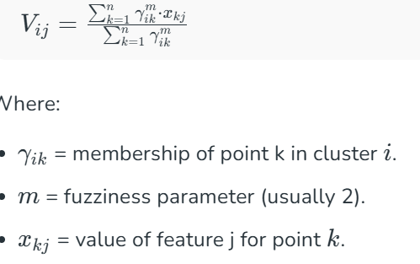
Centroid Vij

Slide 24
Step3-Ditance calculation
Calculate Distance Between Data Points and Centroids:
Compute the Euclidean distance between each point and every centroid to determine proximity, which will be used to update memberships. Example for point (1,3):

Slide 25
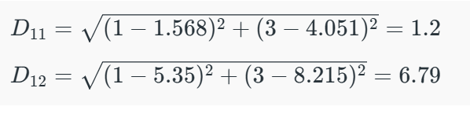
Similarly the distance of all other points is computed from both the centroids.

Slide 26

Step 4-Updata Membership value -
Step 4: Update Membership Values: Membership values are updated inversely proportional to these distances. Points closer to a centroid get higher membership.

Slide 27
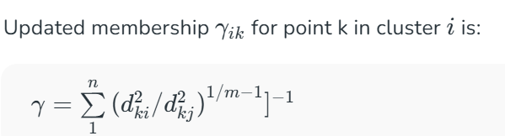
Updated Membership value formulae

Slide 28
Step 5: Repeat Until Convergence
Step 5: Repeat Until Convergence: Steps 2–4 are repeated until the membership values stabilize meaning there are no significant changes from one iteration to the next. This indicates that the clustering has reached an optimal state.

Slide 29
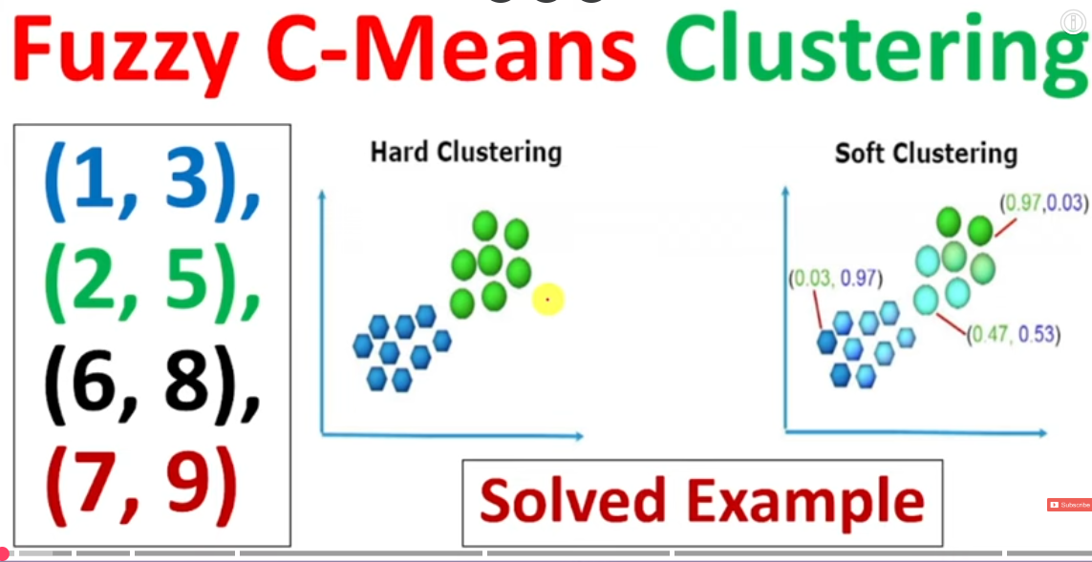
Problem

Slide 30
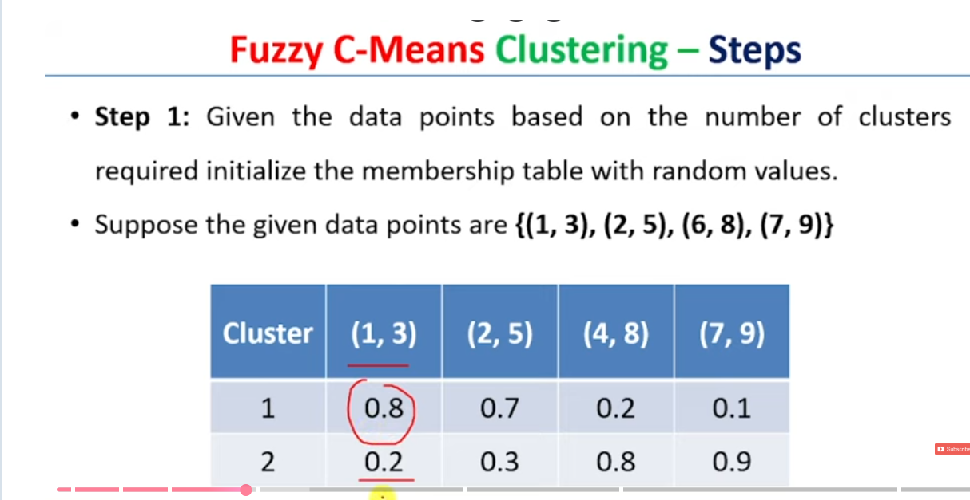
Problem-Step1 –Initialize random membership values to all data points by considering two cluster

Slide 31
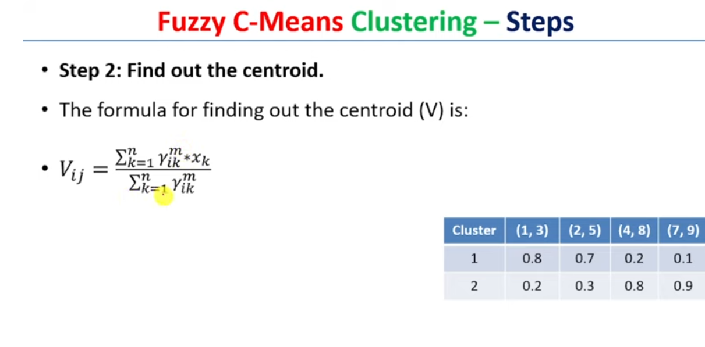
Step 2-Find out Centroid Vij-Total 4 centroids-V11,V12,V21,V22

Slide 32
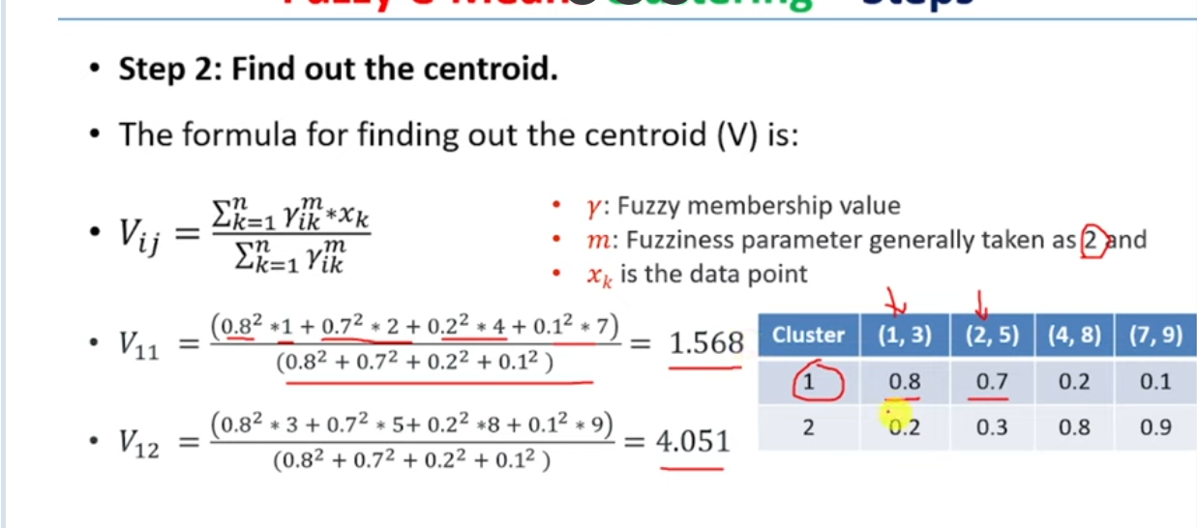
Step 2-Find out Centroid Vij-Total 4 centroids-V11,V12(cluster -1)

Slide 33
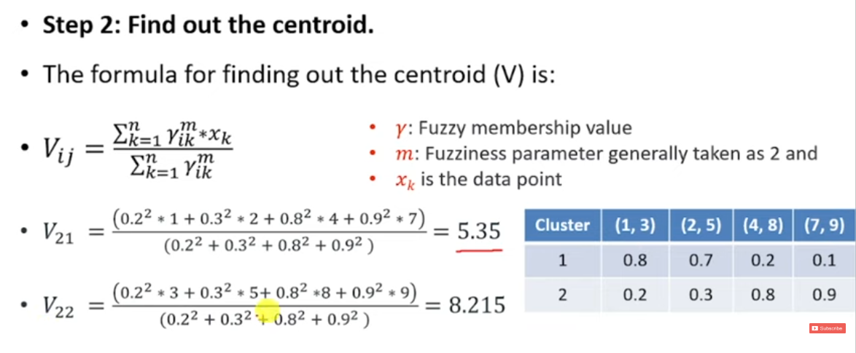
Step 2-Find out Centroid Vij-Total 4 centroids-V21,V22(Cluster 2)

Slide 34
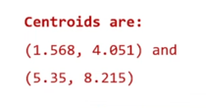
Centroids
V11=1.568,v12=4.051,v21=5.35,v22=8.215

Slide 35
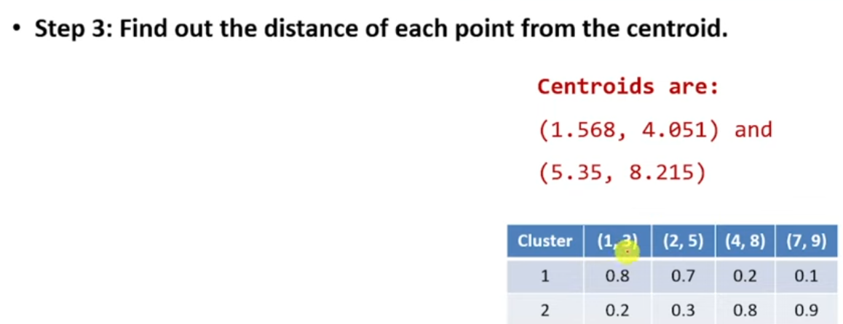
Distance from each point to centroid(D11,D12,D21,D22,D31,D32,D41,D42)-Euclideian Distance

Slide 36
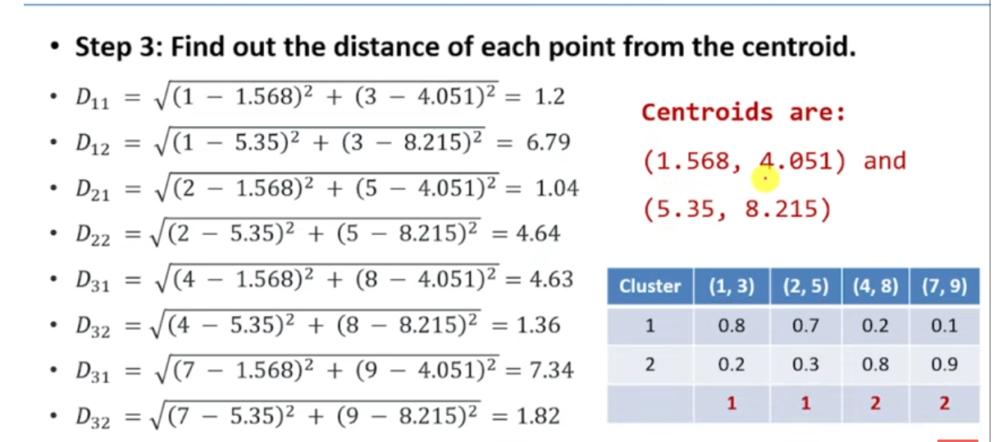

Slide 37
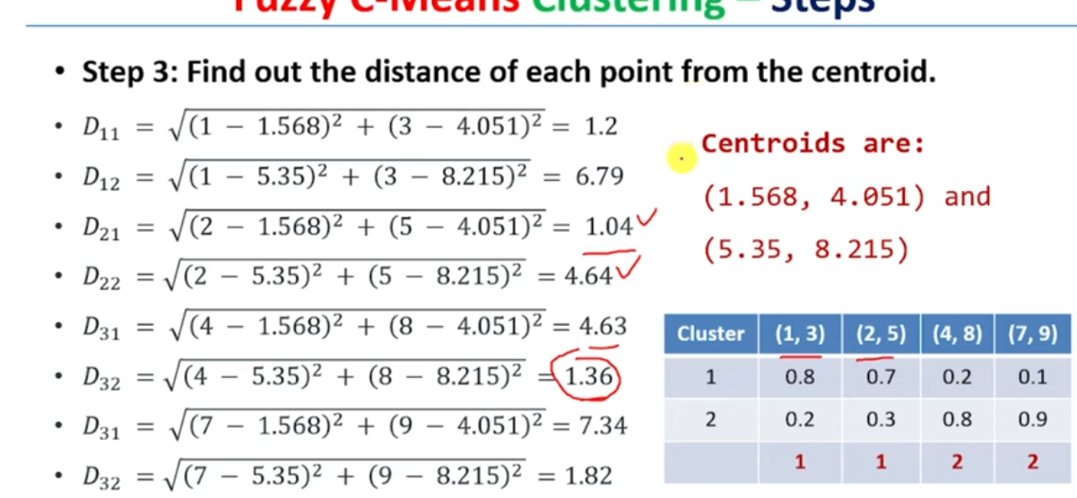
Step3 distance

Slide 38
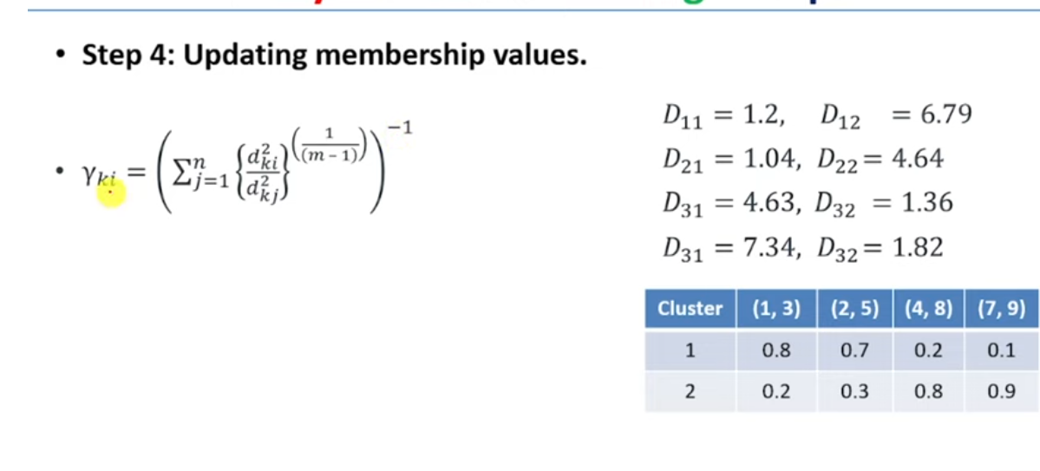
Step 4 –Update Membership value

Slide 39
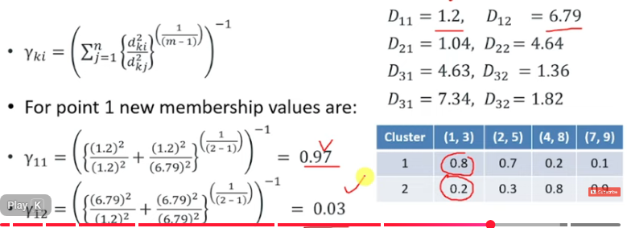
First Data Point Membership values

Slide 40
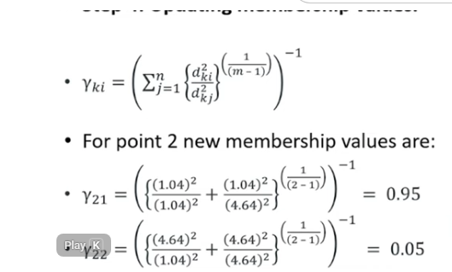
Second datapoint Membership Values

Slide 41
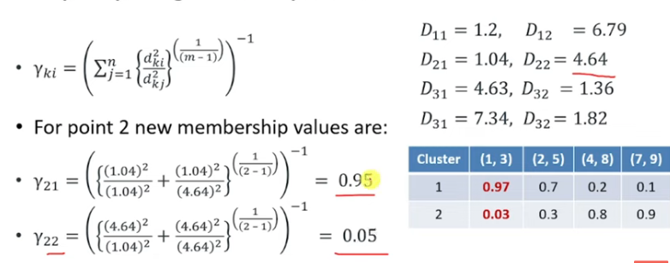

Slide 42
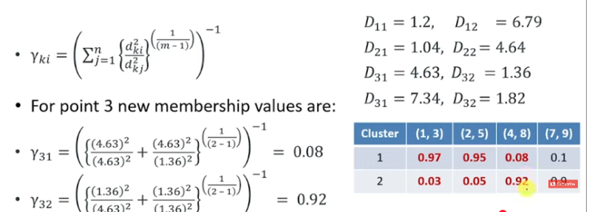

Slide 43
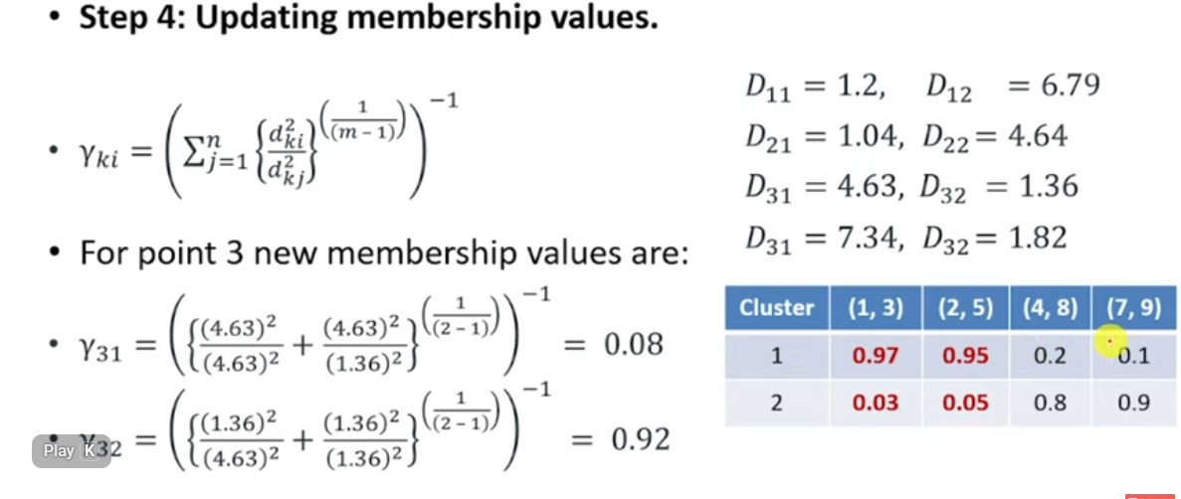

Slide 44
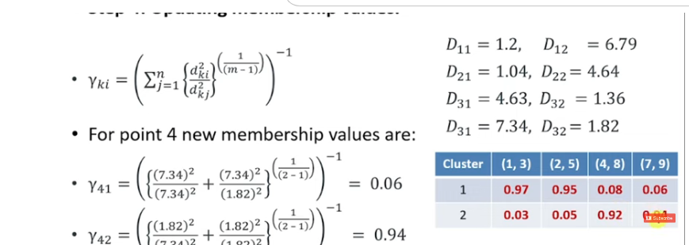

Slide 45
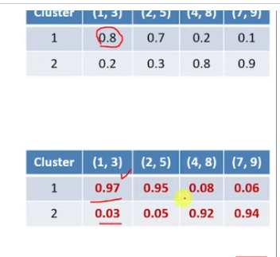

Slide 46
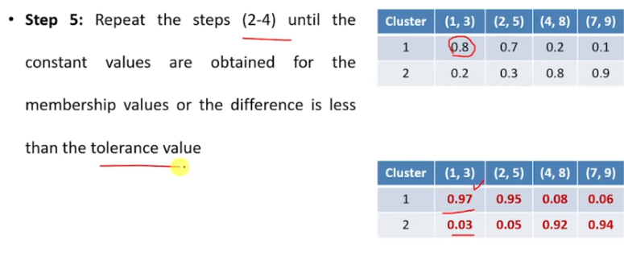

Slide 47
